Slide 1


MBBS Opportunities for Indians in EGYPT

Slide 2

OVERVIEW ABOUT EGYPT
Capital of EGYPT : Cairo
Airport : 10 Airport , Cairo International airport is the largest one.
Currency : Egyptian Pound (EGP) , 1EGP = 4.60 INR
Population : Apprx. 9.84 crores
Climate : Moderate almost same like India.

Slide 3
SOME KEY FEATURES :
GATEWAY TO SETTLE IN US ,UK AND MIDDLE EAST.
USMLE PASSING PERCENTAGE : 80%
PLAB PASSING PERCENTAGE : 75%
MIDDLE EAST MEDICAL EXAM PASSING RATE :93%
ATRACTIVE JOB OFFER IN SAUDAI ARABIA .

Slide 4

ADVANTAGES OF DOING MBBS
FROM EGYPT
State of art best infrastructure.
Hand-picked world class faculty.
English is the medium of study and instruction during the entire course.
Globally recognized and standard curriculum.
Affordable cost and course free.
The climate, study environment and cost of living almost similar to India.
239 -500 in World ranking
High patients flow in 5000 bedded University’s own 9 hospitals
University is teaching MBBS in four language English, French, German and Arabic
Clinical rotations are available in 21 countries like USA , UK, Canada , Germany ,India ,and many more..

Slide 5

Renowned Universities In EGYPT:
There are around 10 Medical Universities in EGYPT ,Some FAMOUS ones are:
Cairo University.
Mansoura University.
Ain Shams University.
Alexandria University.
Suez Canal University and more

Slide 6
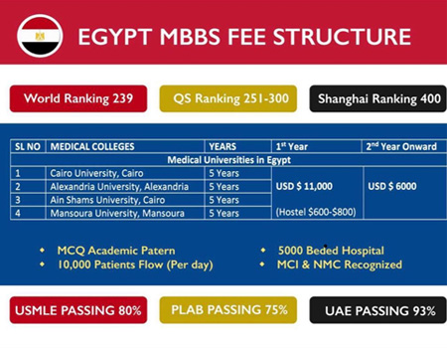
Expenses For MBBS

Slide 7
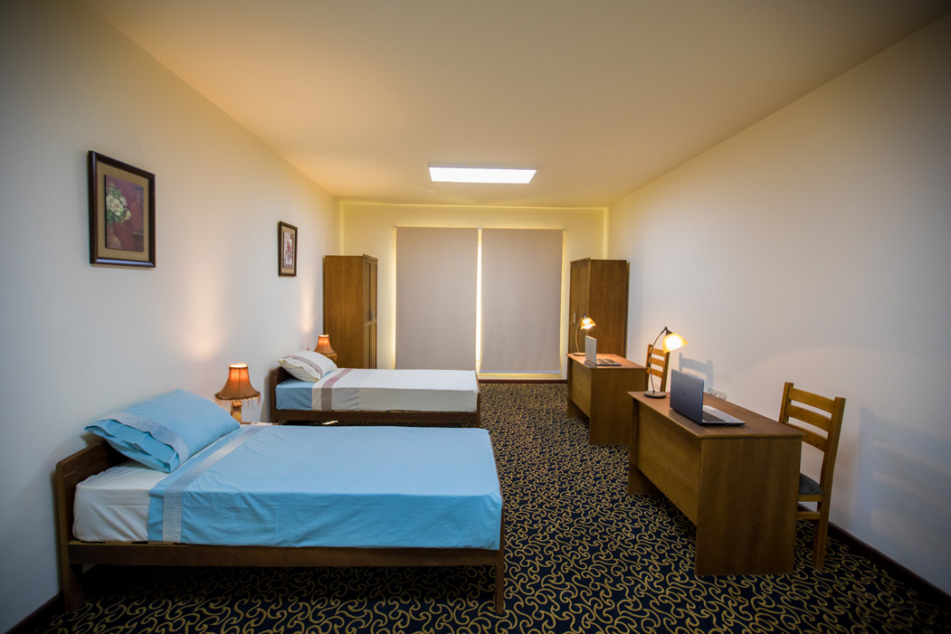
Hostels and Mess
Safe and secure study environment for both male and female students.
Separate hostels for boys and girls with all modern facilities.
Indian food is easily available.
Star rated hostel rooms .
Students can Opt living in apartments.

Slide 8

THANK YOU FOR WATCHING US!
Admissions in TOP RANKED Universities are open now.
CONTACT US FOR BLOCKING YOUR SEAT
IN YOUR DESIRED UNIVERSITY.
OUR CONTACT NUMBER ARE :
+91 8799712271 / +91 9711882248
Visit our website: www.indiaeduspring.com
Like us on Facebook : https://www.facebook.com/Indiaeduspring/

